Slide 1
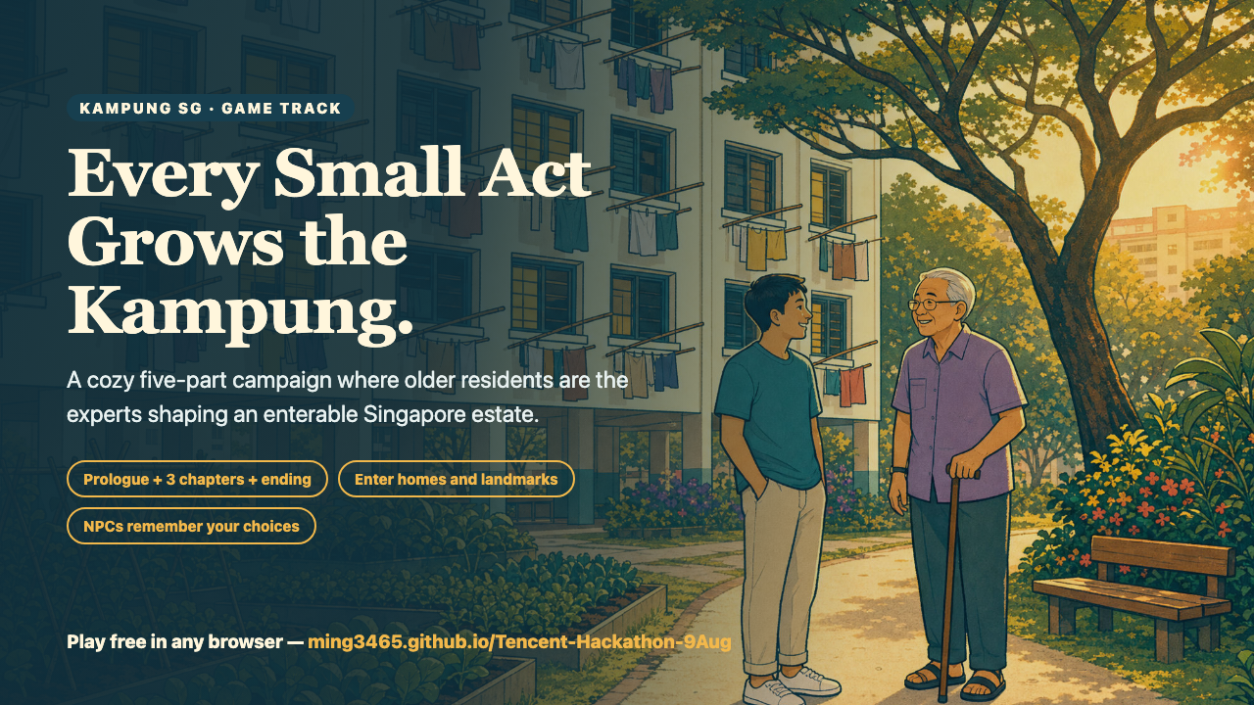
Notes:
Kampung SG is now a five-part campaign. Older residents are not problems to solve; their knowledge moves the story and visibly reshapes an enterable HDB estate. Every small act grows the kampung.

Slide 2
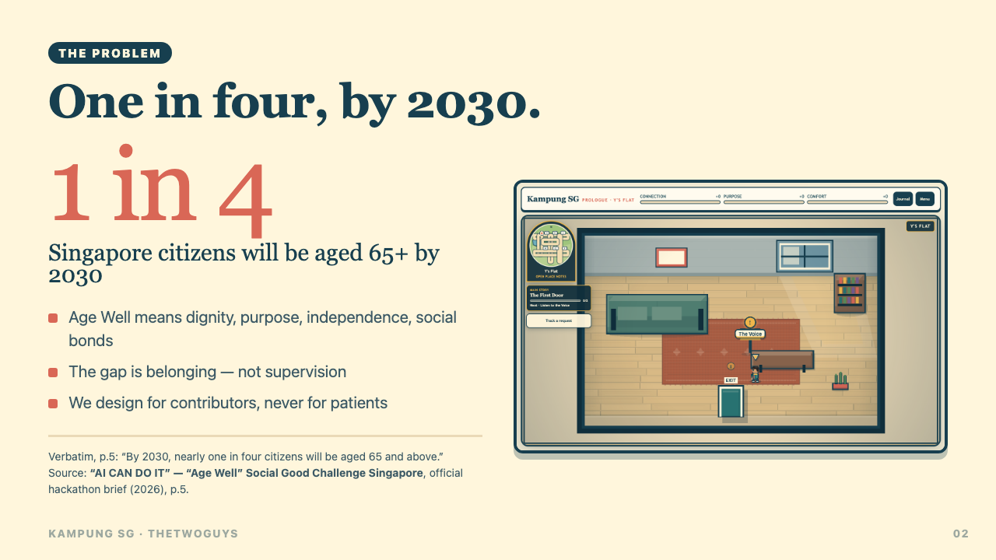
Notes:
The official challenge brief says that by 2030 nearly one in four Singapore citizens will be aged 65 and above. We respond with dignity, purpose, independence and social bonds: contributors rather than patients.

Slide 3
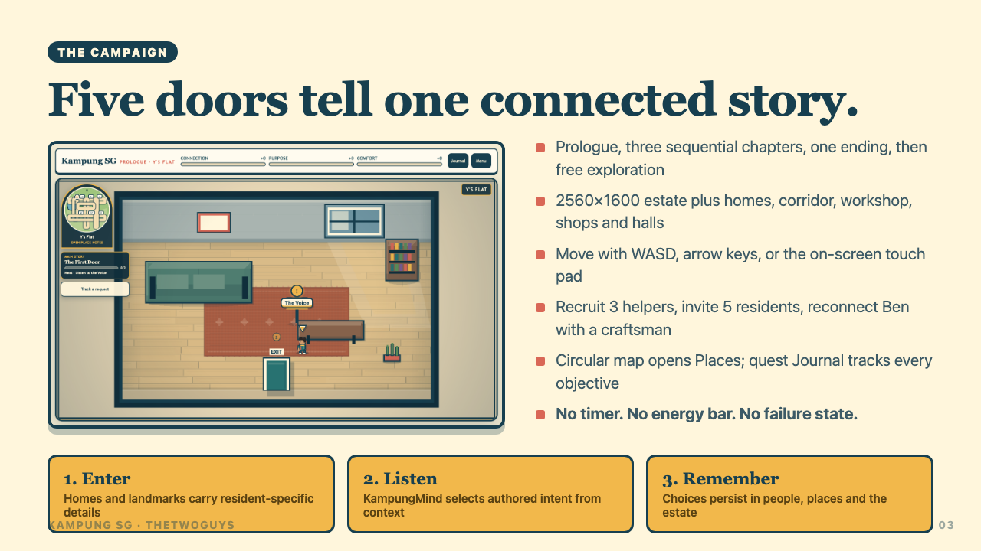
Notes:
The player moves from Y's flat through three sequential chapters and The Last Door, then keeps exploring. Homes, a corridor, workshop, shops and halls are enterable. The full story asks for three helpers and five invitees. There is no timer, energy bar or failure state.

Slide 4
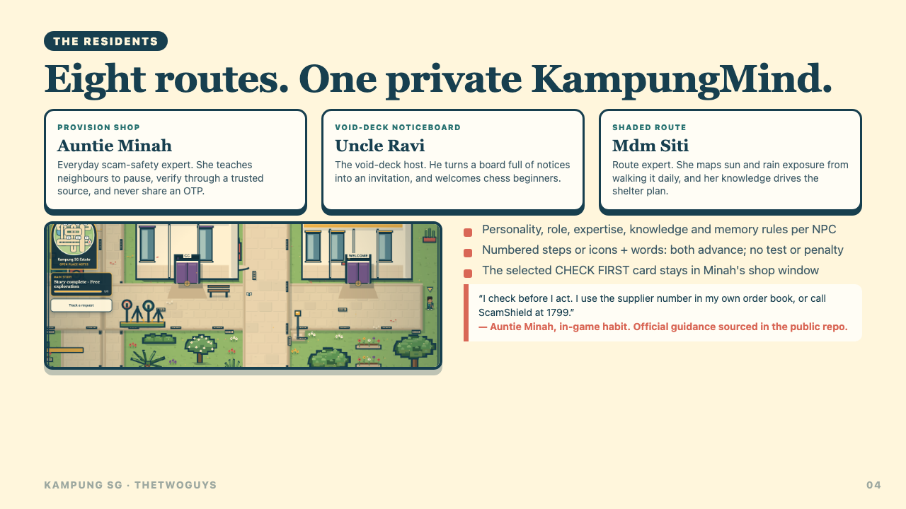
Notes:
KampungMind is the headline AI feature. Each NPC has reviewed personality, role, expertise, knowledge, memory rules and authored intents. Deterministic scoring selects context-appropriate dialogue; stable IDs break ties and no text is generated at runtime.

Slide 5
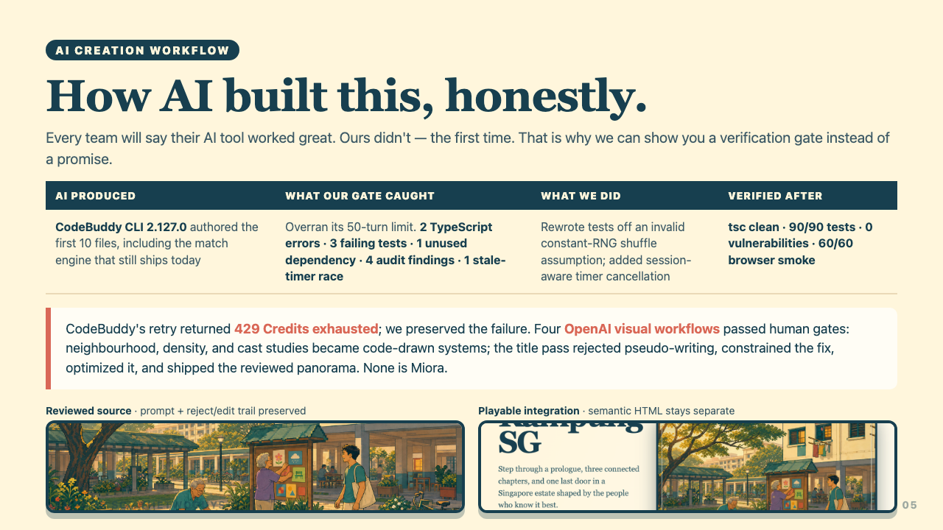
Notes:
Our first CodeBuddy run failed its gate, and the correction attempt hit 429 credits exhausted. We preserved that evidence. Later AI-assisted work added the pure campaign reducer, KampungMind and expanded checks. A real OpenAI image-generation pass produced one visual target; human review rejected direct runtime use and translated its strongest idea into four verified code-drawn activity vignettes. We treat AI output as a pull request, not a deliverable, and we do not relabel this as Miora.

Slide 6
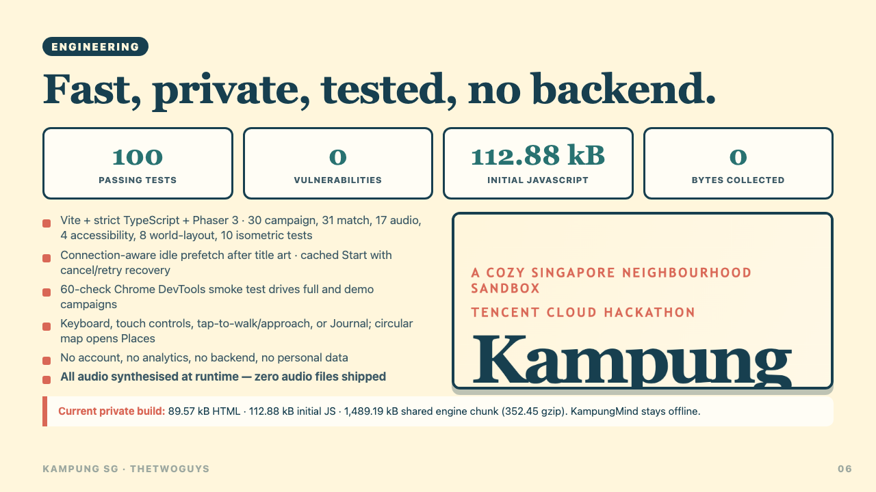
Notes:
Strict TypeScript, 90 unit tests (30 campaign, 31 match, 17 audio, 4 accessibility and 8 world-layout), 60 production-browser checks and zero known vulnerabilities support the current build. The private build is 93.04 kB HTML (16.28 kB gzip), 135.02 kB initial JavaScript (39.95 kB gzip), and 1,602.10 kB lazy scene code (374.15 kB gzip). Connection-aware idle prefetch follows the title art; Start reuses one cached load with cancel/retry recovery. KampungMind and every save remain in the browser: no account, backend, analytics or personal data. Audio is synthesized at runtime.

Slide 7
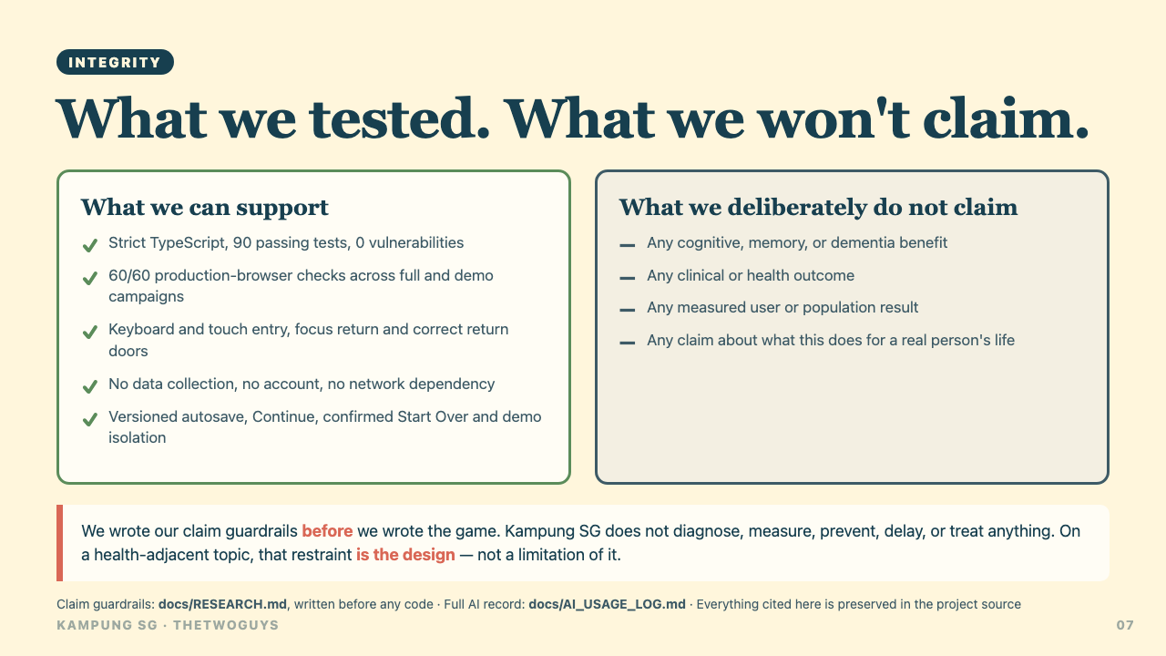
Notes:
We separate software evidence from impact claims. The campaign, persistence, inputs and browser paths are automated; human playtesting, real-device accessibility and any social outcome are not claimed. Kampung SG makes no medical, cognitive, memory or dementia claim.

Slide 8
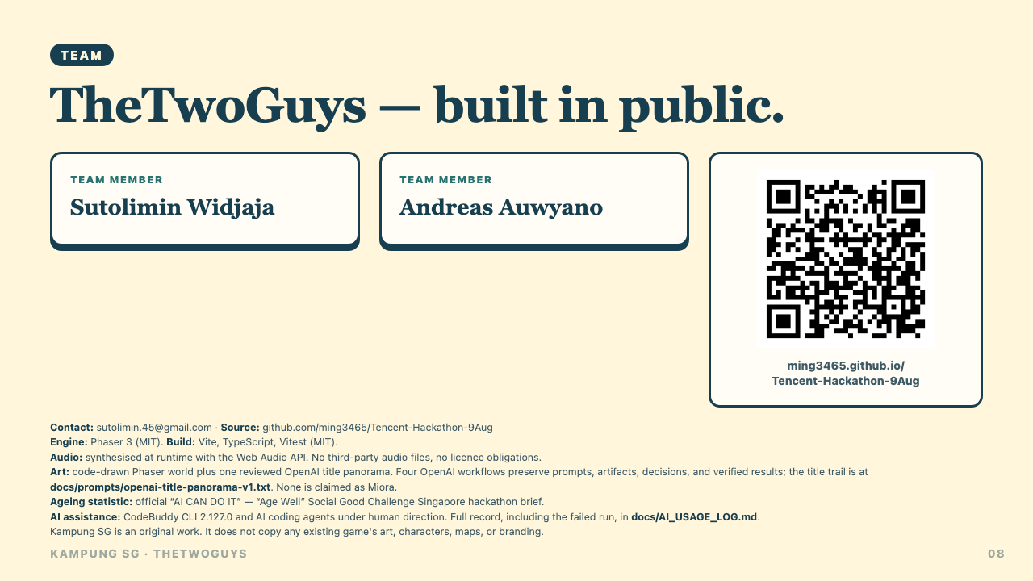
Notes:
We are TheTwoGuys. The public repository contains the current code, prompts, failed-run record, claim guardrails and reproducible gate. The game is playable in a browser with no install or account. Every small act grows the kampung.

